Slide 1
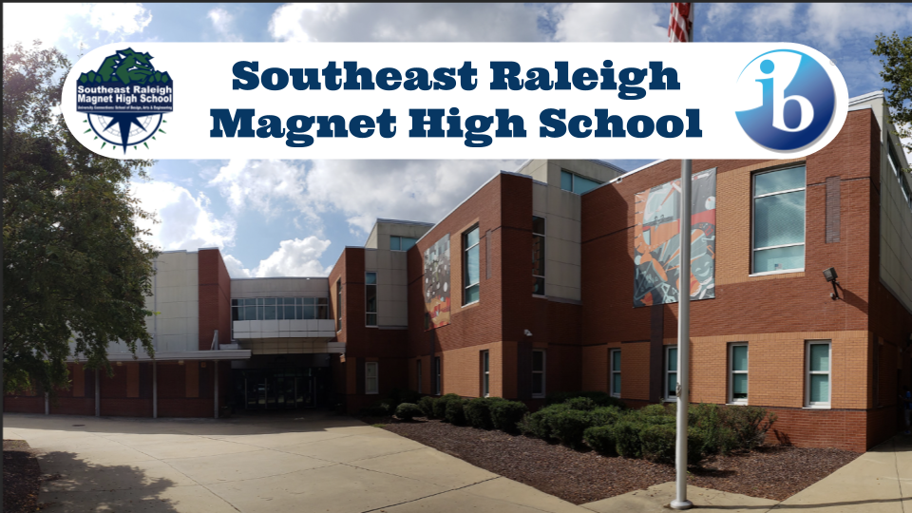
Notes:
Registration
Dance Performance
Welcome and Introductions
Welcome to Southeast Raleigh Magnet High School. Messages and introductions from Principal Harden, Administration, and Support Staff
Band Performance
Student and Parent Break-outs
Nut and Bolts of what it takes to be successful (Kuhn, any other counselors)
Technology/Preparation
Update contact information
Powerschool
Difference between HS and MS
Get Involved
Clubs/Organizations
After school programs
Athletics
Academies (Biomed, Engineering & IT)/ IB/ Magnet (Arts, Design, Engineering and Humanities)
UC Courses

Slide 2
GET INVOLVED

Slide 3
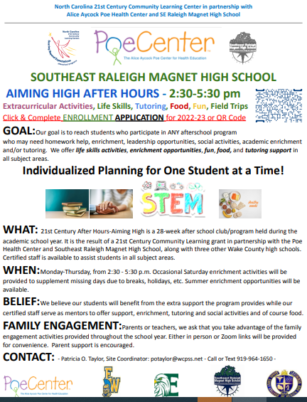

Slide 4
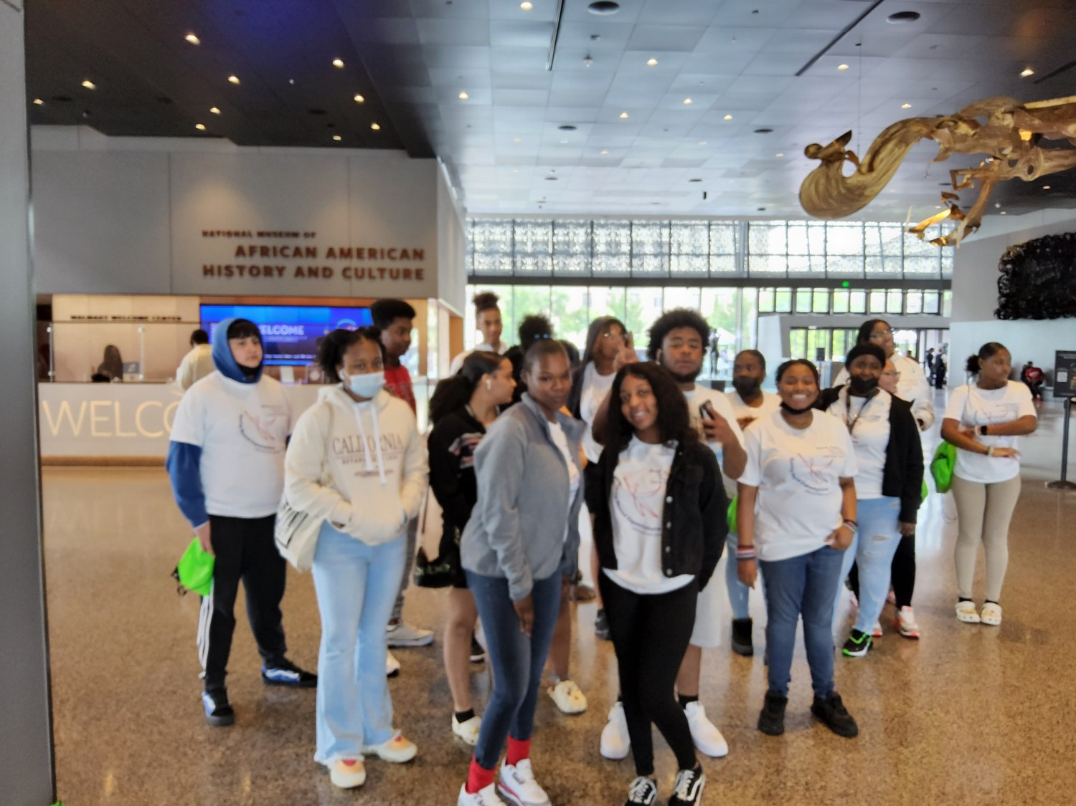
Aiming High After Hours GET INVOLVED IN ALL THINGS AFTER SCHOOL
Monday-Thursday
2:30-5:30
Room 204
200 Hallway

Slide 5
The Program
Life Skills/Social Emotional Wellness /Homework Help, Tutoring with Certified Staff
Medical Math Monday, Terminology Tuesday, Wellness Wednesday, Take A Moment Thursday
Discussions. Safe place to talk freely
Free Food
Free Field Trips: Regular attendance
SIGN UP TODAY: Website

Slide 6
FIELD TRIPS
UPCOMING FIELD TRIPS | 2022 DATE(S) OF TRIP/ACTIVITIES | PURPOSE OF TRIP/ACTIVITY
NC Zoo, Asheboro, North Carolina | Friday, August 19 | Learn about animals in the habitat and careers in the healthcare field that pertain to animal care.
Museum of Life and Science Durham, North Carolina | Saturday, September 17 | Participate in healthcare related field trips to gain exposure to healthcare related careers and exposure to STEM activities. Learn how life and science correlate with one another.
NASA Air and Space Center Hampton, Virginia | Saturday, September 24 | Participate in healthcare related field trips to gain exposure to healthcare related careers and exposure to STEM activities. Learn more about Space and Air.
Greensboro Science Center Greensboro, North Carolina | Saturday, October 22 | Participate in healthcare related field trips to gain exposure to healthcare related careers and exposure to STEM activities. At SKYWILD students will imitate animal actions to allow them a better understanding and greater appreciation for the diversity of life.

Slide 7
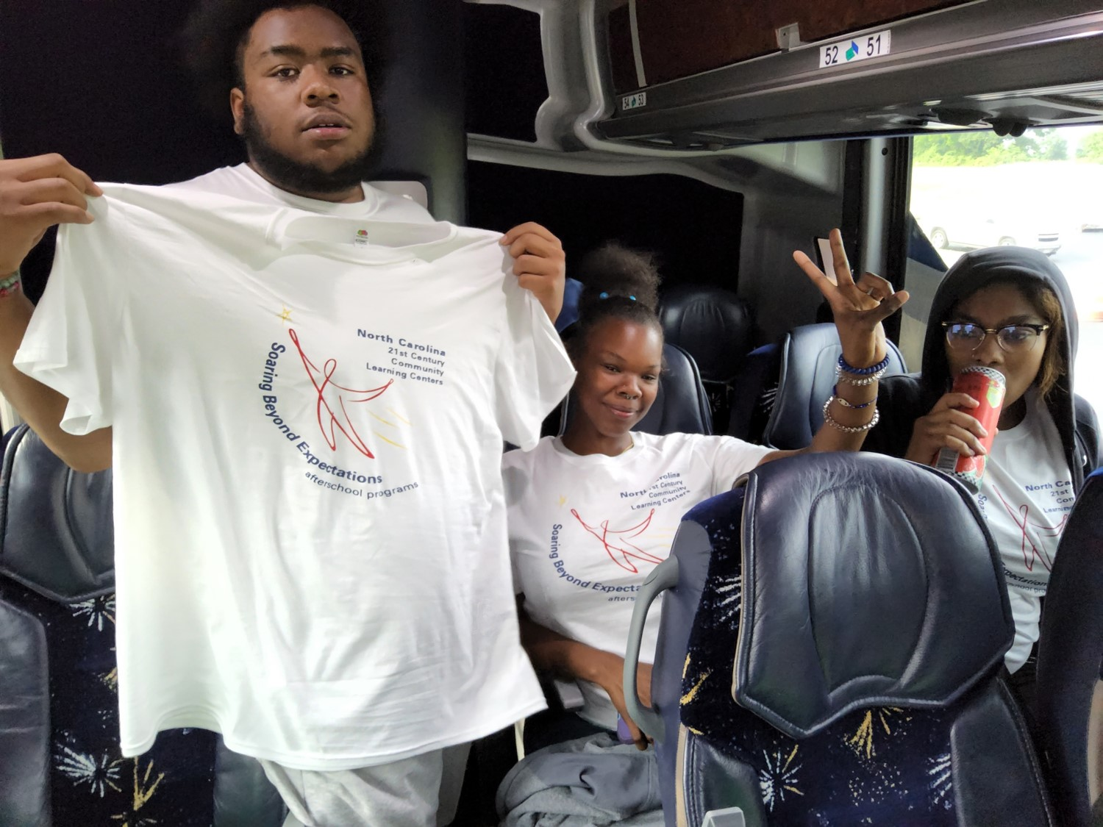
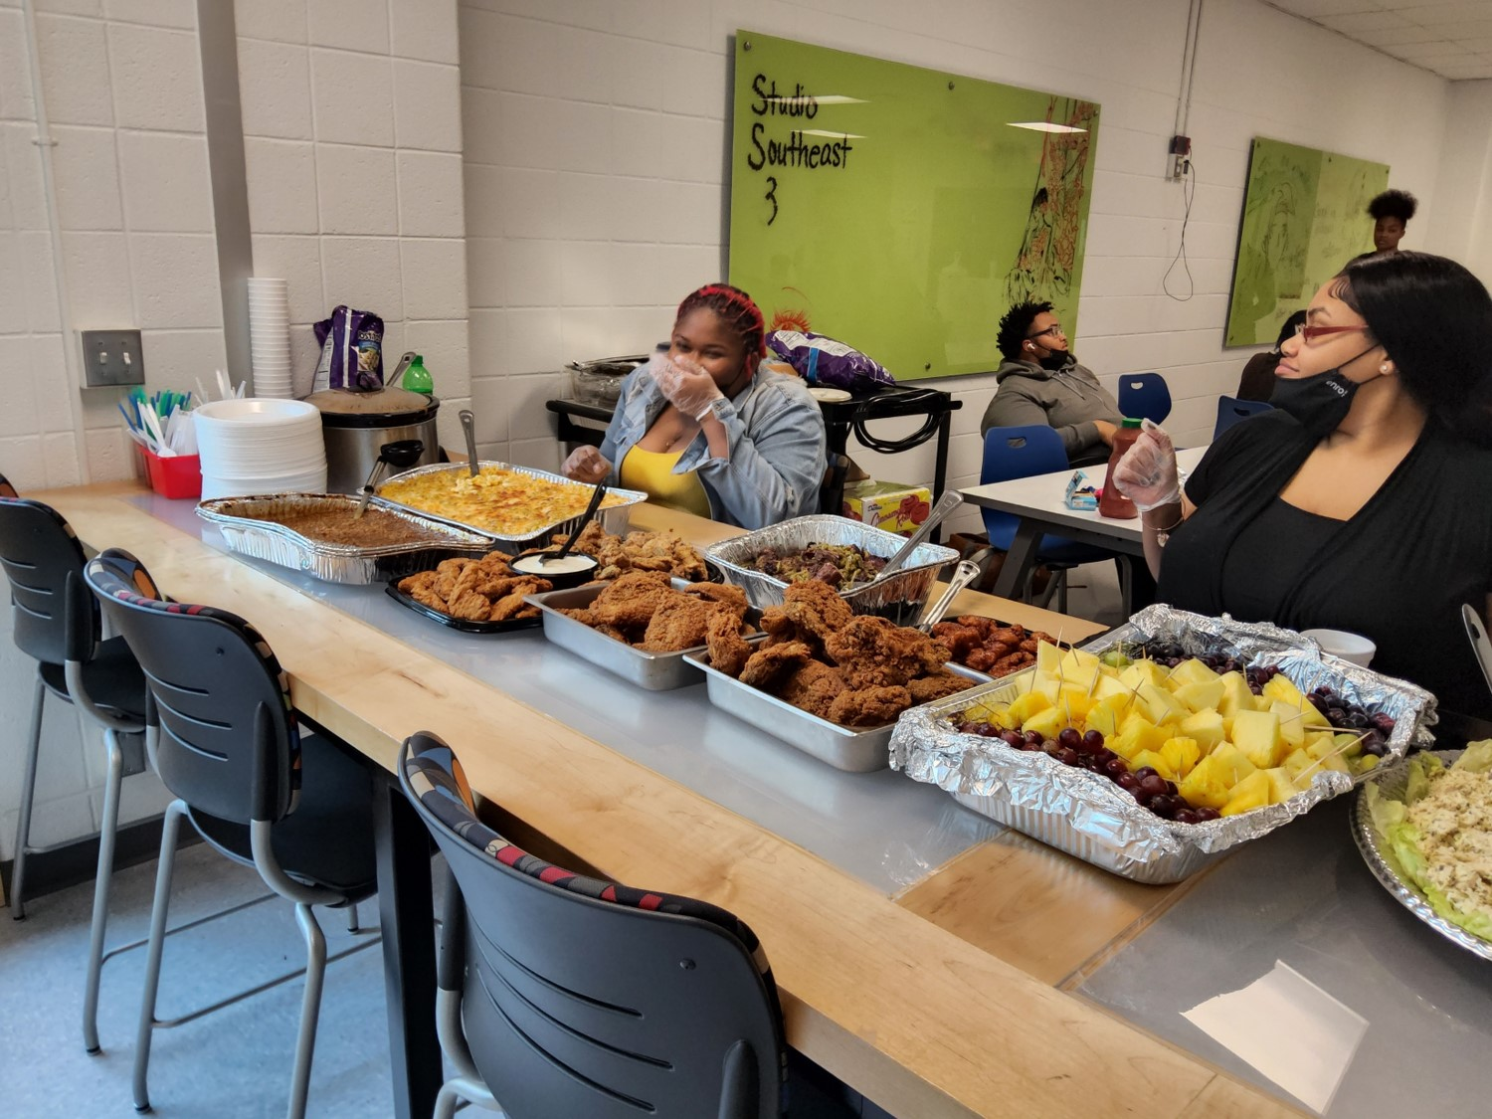
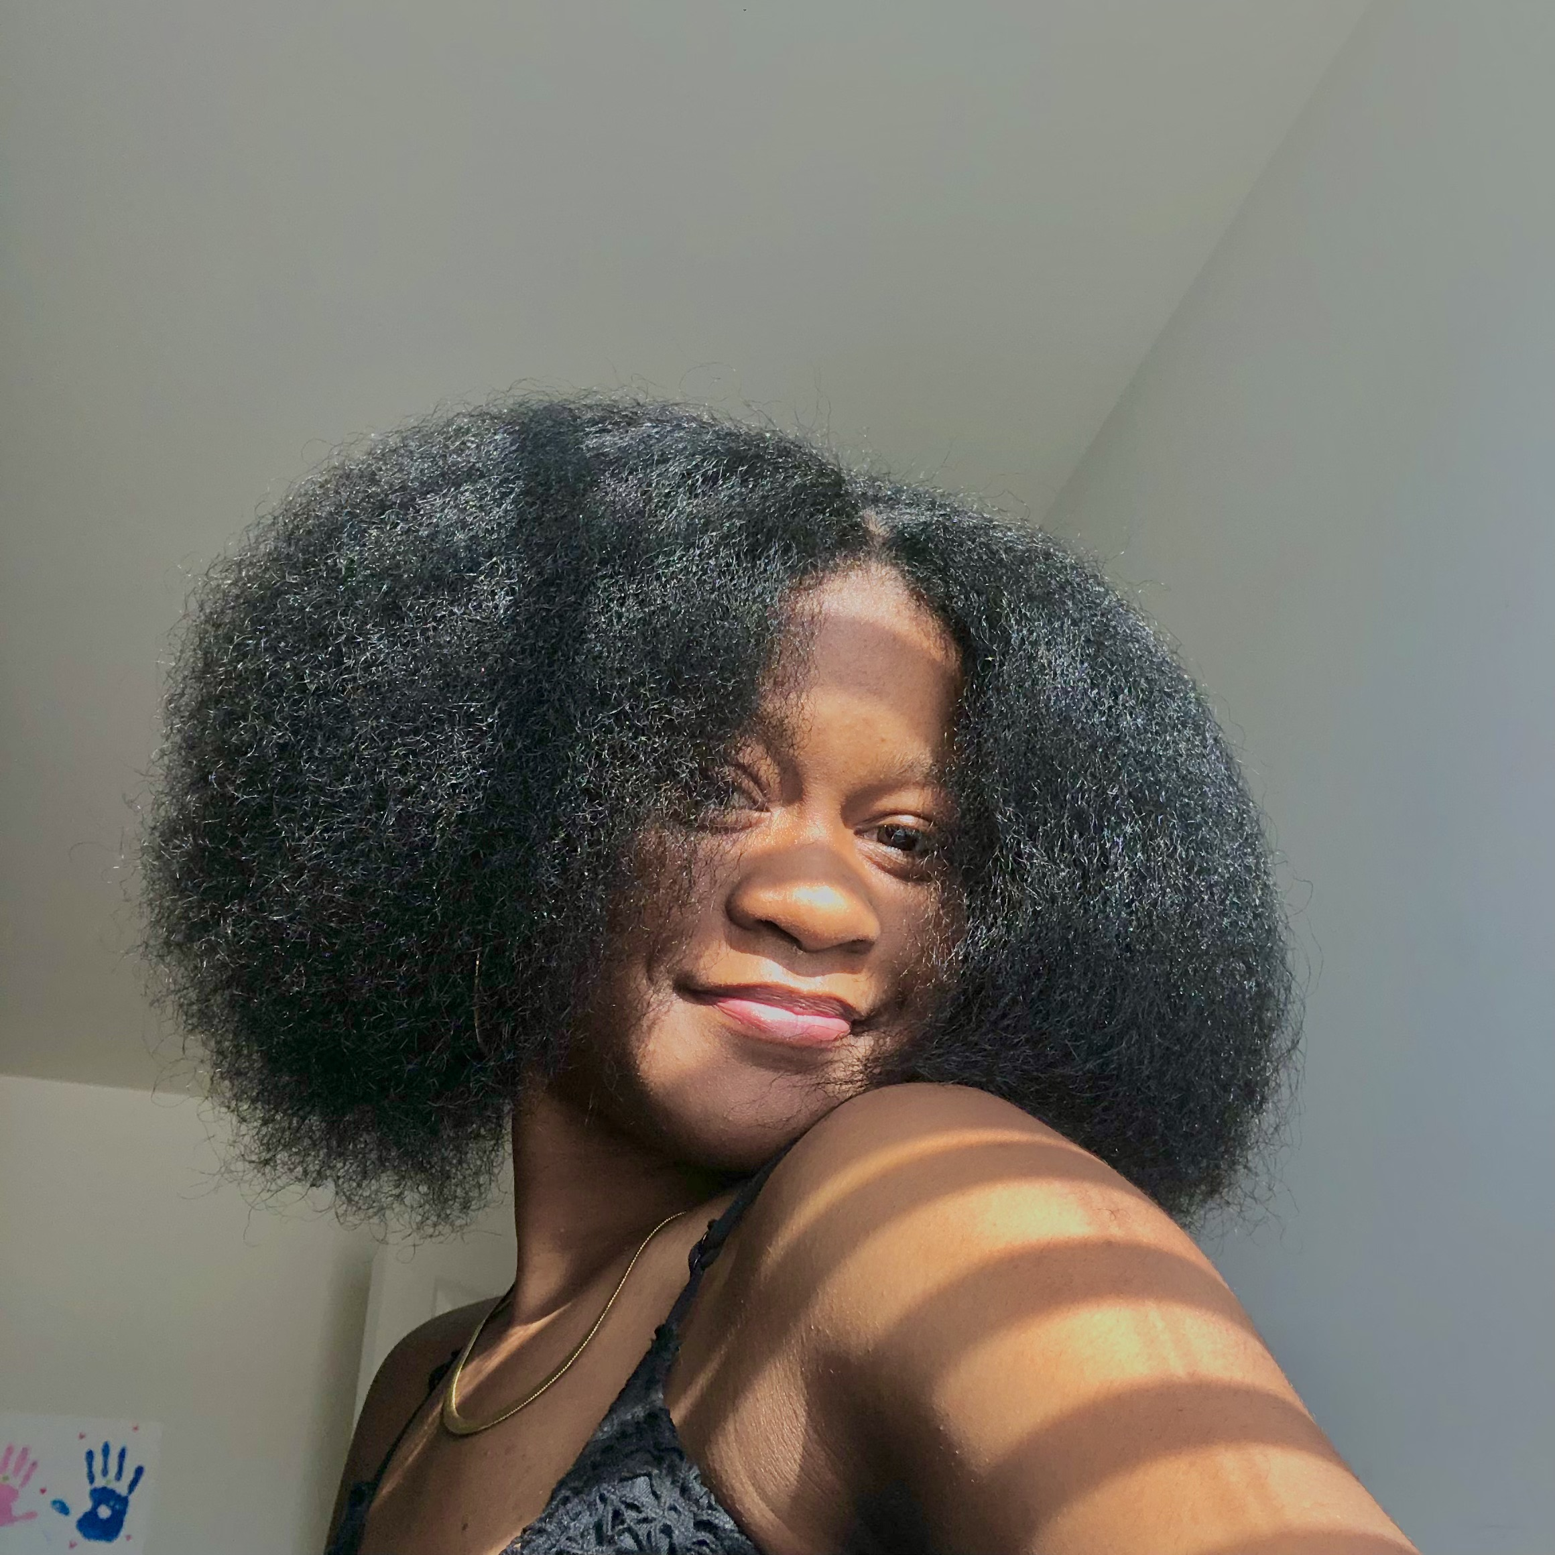
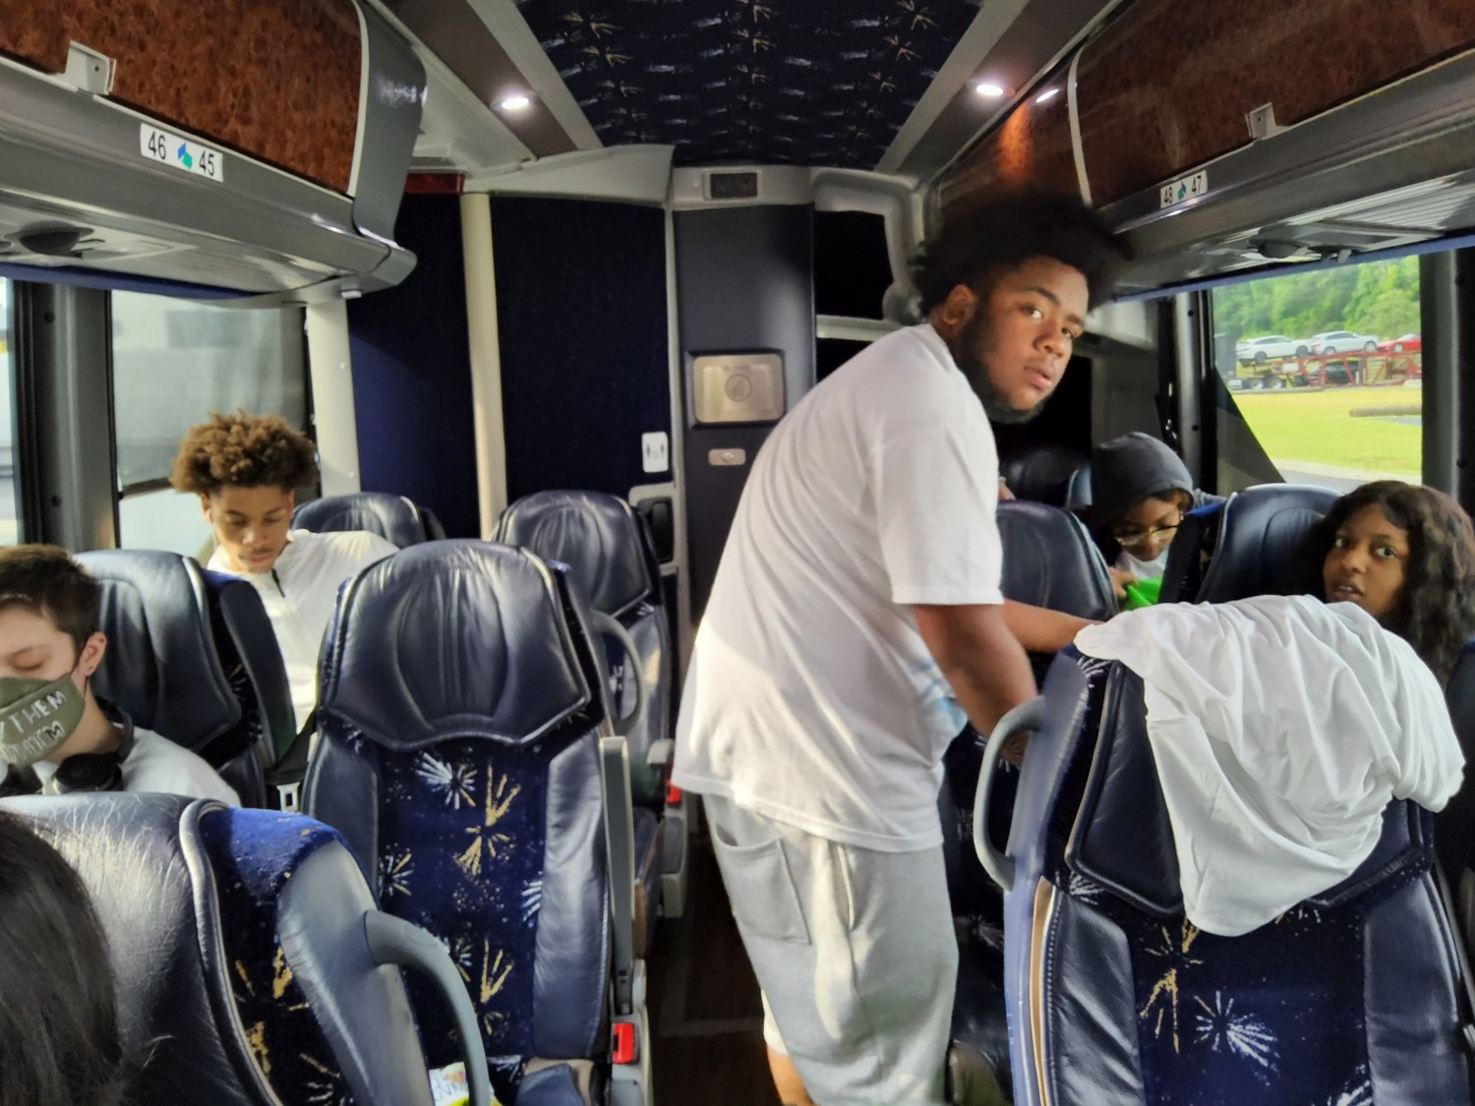
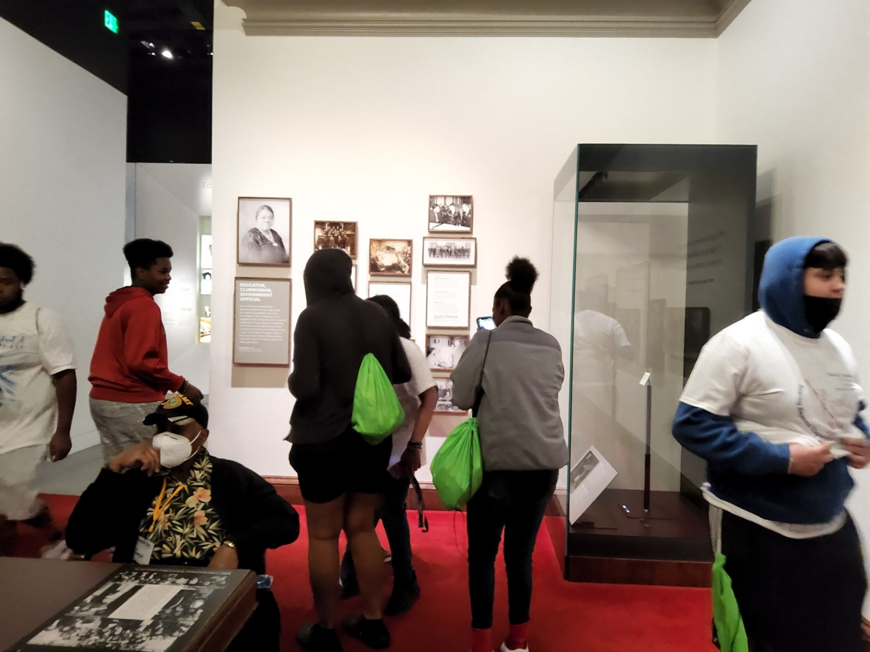

Slide 8
Aiming High After Hours STAFF
Mrs. Po Taylor, Site Coordinator
Ms. Lynch
Ms. Orner
Ms. Jones
Ms. Rosario
Mr. Wooden
Mr. Ormond
Mr. Kuhn
This program is dedicated to the vision of Ms. Gary who founded the name Aiming High. JOIN TODAY on Southeast Raleigh Website!

